Slide 1
PROJECT ASSIGNMENT 3
SQL
–

Slide 2
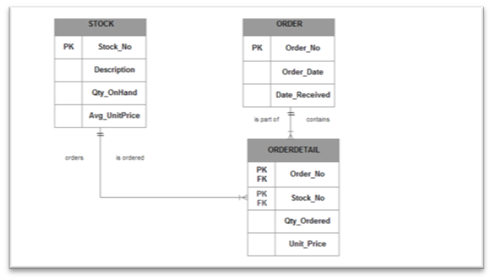
DATAMODEL

Slide 3
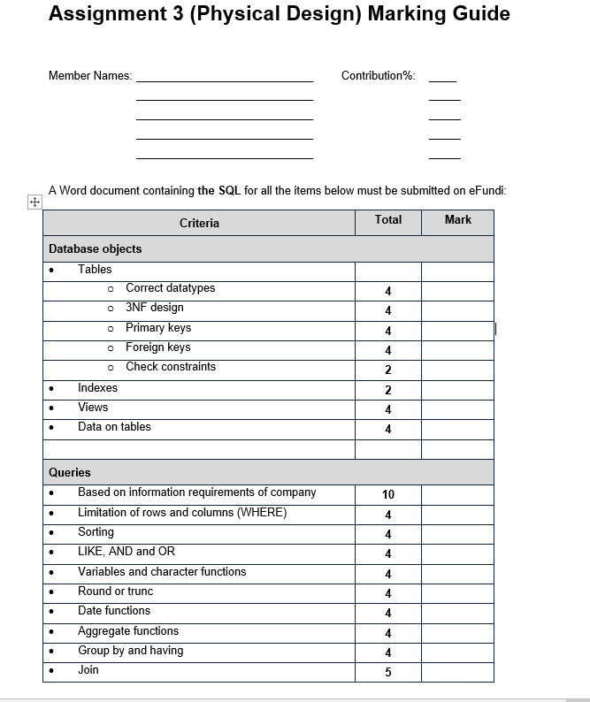
PROJECT MARKING GUIDE

Slide 4
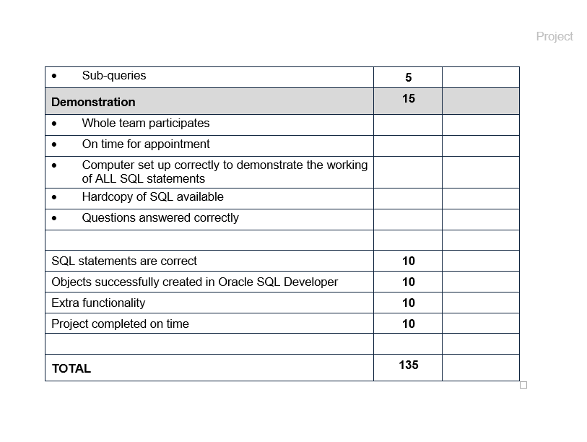

Slide 5
CREATE TABLE STOCK
CREATE TABLE STOCK
( Stock_no NUMBER(6)
CONSTRAINT stock_stock_no PRIMARY KEY,
Description VARCHAR2(30),
Qty_OnHand NUMBER(5) NOT NULL,
Avg_UnitPrice NUMBER(9,2) NOT NULL
CONSTRAINT avg_unit_price_ck CHECK (Avg_UnitPrice >0));

Slide 6
CREATE TABLE ORDER
CREATE TABLE PORDER
(Order_no NUMBER(6)
CONSTRAINT order_order_no PRIMARY KEY,
Order_Date DATE,
Date_Received DATE NULL);

Slide 7
CREATE TABLE ORDER DETAIL
CREATE TABLE ORDER_DETAIL
(Order_no NUMBER(6)
CONSTRAINT order_no_fk REFERENCES PORDER (order_no),
Stock_no NUMBER(6)
CONSTRAINT stock_no_fk REFERENCES STOCK (stock_no),
Qty_ordered NUMBER(5) CHECK (Qty_ordered >0),
Unit_Price NUMBER(9,2) CHECK (Unit_Price >0),
CONSTRAINT order_detail_pk PRIMARY KEY (order_no, stock_no));

Slide 8
CREATE VIEWS
CREATE OR REPLACE VIEW order_detailvu01
AS SELECT order_date, order_no, stock_no, Qty_ordered *Unit_price "Order Value"
FROM order_detail
NATURAL JOIN porder
ORDER BY order_date;

Slide 9
CREATE VIEWS
CREATE OR REPLACE VIEW order_detailvu02
AS SELECT order_date, SUM(Qty_ordered * Unit_price) "Order Value Per Date"
FROM order_detail
NATURAL JOIN porder
GROUP BY order_date;

Slide 10
CREATE SEQUENCES
CREATE SEQUENCE stock_stock_no_seq
INCREMENT BY 1
START WITH 1
MAXVALUE 999999
NOCACHE
NOCYCLE;

Slide 11
CREATE SEQUENCES
CREATE SEQUENCE porder_order_no_seq
INCREMENT BY 1
START WITH 1
MAXVALUE 999999
NOCACHE
NOCYCLE;

Slide 12
INSERT VALUES INTO STOCK
INSERT INTO STOCK (stock_no, description, Qty_OnHand, Avg_UnitPrice)
VALUES (stock_stock_no_seq.NEXTVAL,'HB Pencil', 150, 6.30);
INSERT INTO STOCK (stock_no, description, Qty_OnHand, Avg_UnitPrice)
VALUES (stock_stock_no_seq.NEXTVAL,'Parker Pen', 50, 325.25);

Slide 13
INSERT VALUES INTO PORDER
INSERT INTO PORDER (order_no, order_date,date_received)
VALUES (porder_order_no_seq.NEXTVAL,SYSDATE, null);
INSERT INTO PORDER (order_no, order_date,date_received)
VALUES (porder_order_no_seq.NEXTVAL,SYSDATE, null);

Slide 14
INSERT VALUES INTO ORDER_DETAIL
INSERT INTO ORDER_DETAIL (order_no, stock_no, qty_ordered,unit_price)
VALUES (1,1, 6,6.3);
INSERT INTO ORDER_DETAIL (order_no, stock_no, qty_ordered,unit_price)
VALUES (1,2, 5,325.25);

Slide 15
JOIN
SELECT order_no, order_date, description, qty_ordered, unit_price
From PORDER
NATURAL JOIN ORDER_DETAIL
NATURAL JOIN STOCK;

Slide 16
SUBQUERY
SELECT order_no, order_date, description, qty_ordered, unit_price
from PORDER
NATURAL JOIN ORDER_DETAIL
NATURAL JOIN STOCK
WHERE unit_price < (SELECT AVG(AVG_UnitPrice)
FROM STOCK)

